Slide 1



ABC CALL VOLUME TREND ANALYSIS
Trainity Project By Vaishakh Menon

Slide 2

Project Description
Content
Approach
Tech-Stack Used
Insights
Result

Slide 3
Project Description
The Customer Experience (CX) team is a vital component of any company, as they are tasked with analyzing customer feedback and data to extract valuable insights. These insights are then shared across the organization. The team's responsibilities encompass managing customer experience programs, internal communications, customer journey mapping, and customer data management.
In the contemporary era, a multitude of AI-powered tools are employed to enhance the customer experience. These tools encompass Interactive Voice Response (IVR), Robotic Process Automation (RPA), Predictive Analytics, and Intelligent Routing.
Within a CX team, one of the primary roles is that of the customer service representative, also known as a call center agent. These agents are responsible for managing various types of support, including email, inbound, outbound, and social media support.

Slide 4
The specific focus of this project is on inbound customer support, which involves handling incoming calls from both existing and potential customers. The ultimate goal is to attract, engage, and delight customers, thereby fostering their loyalty and advocacy for the business.
Business Understanding
Marketing is an essential component for any business, as it drives sales and creates awareness among consumers about the company's offerings. The way a business advertises itself often influences the first impressions formed by potential customers.
This project will require you to apply our analytical skills to examine the call volume patterns of the CX team and extract valuable insights from the data.

Slide 5
1. Analyze the dataset by identifying its characteristics through descriptive statistics.
2. Display the data trends through visualization techniques.
3. Determine the minimum number of agents required to uphold service levels for optimization purposes.
4. By employing the average function and elementary arithmetic operations, a more straightforward methodology was adopted to ascertain the absolute minimum of agents required.
5. The necessity of data quality assurance cannot be overstated when it comes to conducting accurate analysis. The dependability of the outcomes is contingent upon the credibility of the assumptions. Adapting to varying service level benchmarks and the unpredictable nature of call traffic poses challenges.
Approach

Slide 6


Tech-Stack Used
Microsoft Excel
Microsoft Powerpoint

Slide 7
Insights
Reference :-Excel sheet

Slide 8
The average duration of all incoming calls received by agents needs to be determined. This calculation should be performed for each time bucket.
What is the average duration of calls for each time bucket?
1. Average Call Duration

Slide 9
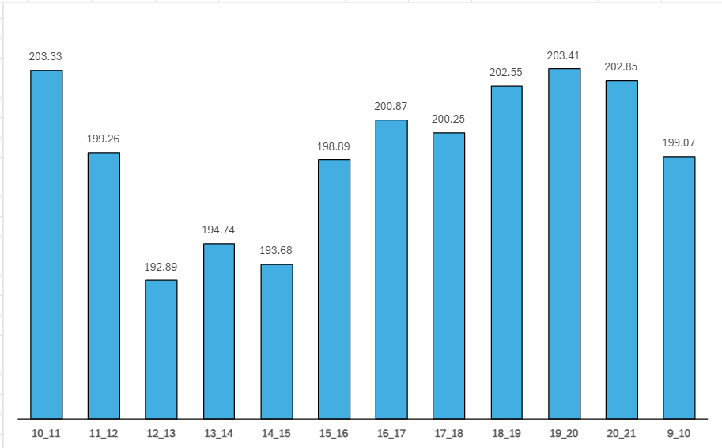
The data highlights significant variations in call duration depending on the time of day. It shows that calls typically last the longest between 7 and 8 PM (time bucket 19-20), whereas the shortest average duration is recorded between 12 and 1 PM (time bucket 12-13).
These findings suggest that there are distinct patterns in call length that correspond to different times of the day. Several factors, such as limited availability of agents, more complex calls, or increased client interaction during nighttime hours, could contribute to the longer average duration during that period. On the other hand, a lower call volume or a quicker response to customer concerns may be inferred from the shorter average duration in the afternoon.

Slide 10
Illustrate the complete tally of received calls by presenting it in the form of a graph or chart. This visual depiction should exhibit the number of calls over a given timeframe. The time intervals should be segmented into buckets, for example, 1-2, 2-3, and so on.
Can you create a chart or graph that shows the number of calls received in each time bucket?
2. Call Volume Analysis

Slide 11
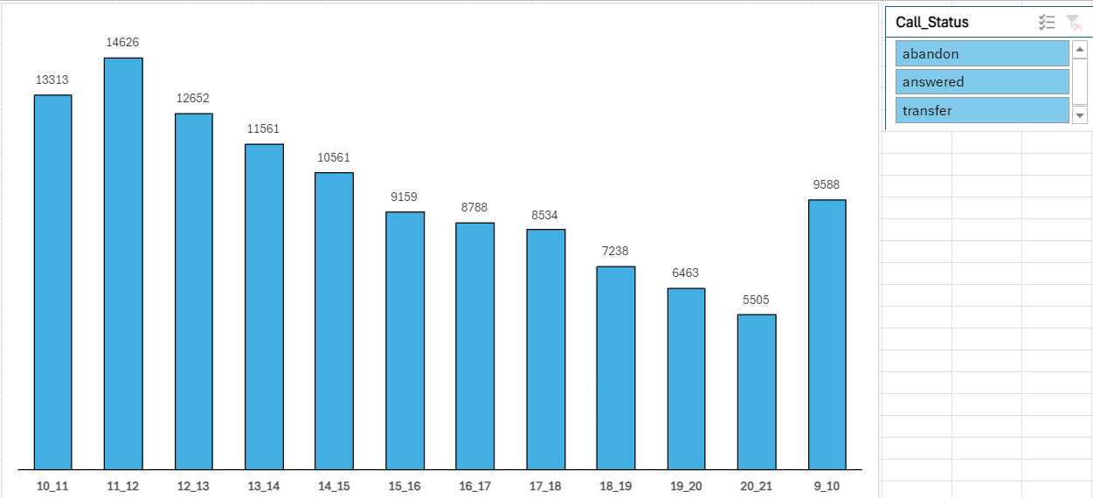
The research indicates variations in call volume during different time periods. It specifically shows that the highest number of calls occur between 11 AM and 12 PM, whereas the lowest number is recorded between 8 PM and 9 PM.

Slide 12
Currently, the abandonment rate is at approximately 30%. To bring this rate down to 10%, a strategy for manpower allocation during each time slot from 9 am to 9 pm must be suggested. This strategy should determine the minimum number of agents required in each time bucket to ensure that at least 90 out of 100 calls are answered.
What is the minimum number of agents required in each time bucket to reduce the abandon rate to 10%?
3. Manpower Planning

Slide 13
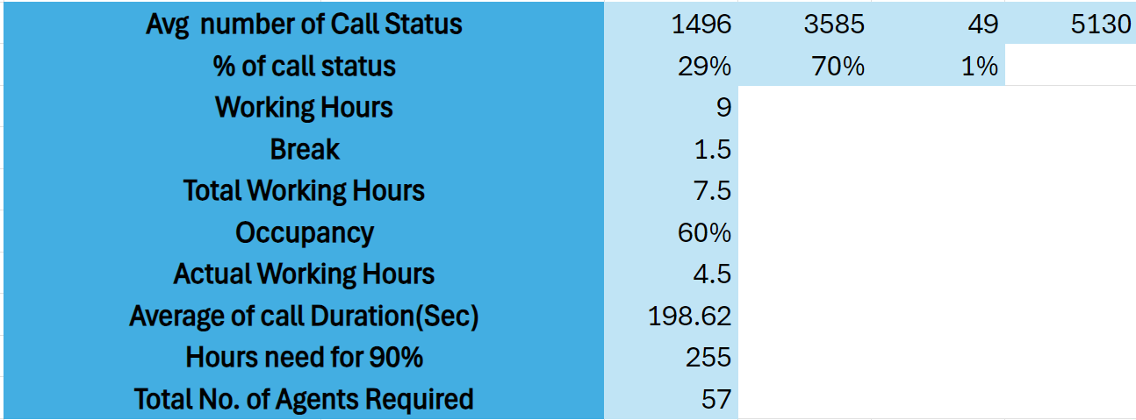
Under the given assumptions, each agent is scheduled to work for 7.5 hours per day, six days a week. Out of this time, approximately 60% is dedicated to answering calls. This means that an agent would spend approximately 4.5 hours per day handling calls.
After conducting a comprehensive analysis, we determined that a total of 57 agents are required to ensure adequate coverage and maintain a service level where at least 90 out of 100 calls are answered. This calculation took into consideration the total number of hours needed to manage incoming calls across all time slots, which amounted to 254.7 hours. By meeting the expectations for call volume and ensuring customer satisfaction, this analysis enables effective planning of the workforce and allocation of resources.

Slide 14
ABC Insurance Company receives calls from customers at night as well, but unfortunately, due to the unavailability of agents, these calls go unanswered. Consequently, this situation leads to a subpar customer experience. It is worth noting that out of every 100 calls made by customers between 9 am and 9 pm, an additional 30 calls are made during the night between 9 pm and 9 am. The distribution of these 30 calls is as follows:
Propose a manpower plan for each time bucket throughout the day, keeping the maximum abandon rate at 10%.
4. Night Shift Manpower Planning

Slide 15
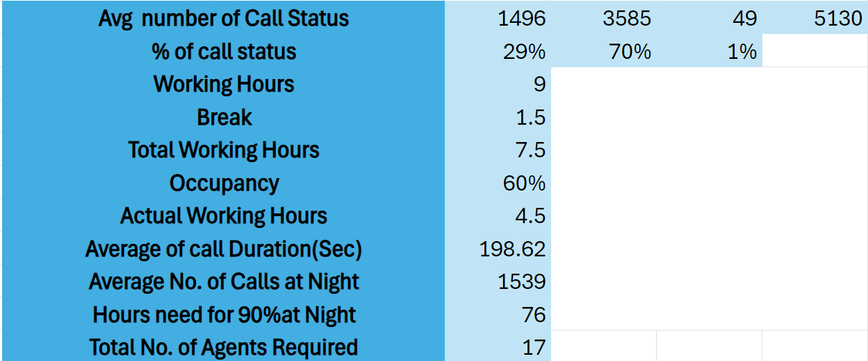
Following a comprehensive evaluation of the provided assumptions and an estimation of the average number of calls made during the night shift in 1539, it has been ascertained that approximately 17 agents are required to attain a 90% call rate. This facilitates efficient personnel scheduling, guarantees sufficient coverage to address call volume requirements, and maintains service quality levels during the nocturnal period.

Slide 16
This analysis has provided me with a wealth of knowledge on call volume trends, call duration factors, and personnel planning. Knowing how call volumes change throughout the day will assist me in effectively managing resources to address customer queries. By examining conversation duration, I have deepened my understanding of call complexity and customer engagement, enabling me to better allocate agent efforts. I have honed my personnel planning skills by implementing simpler strategies and demonstrating flexibility with analytical approaches. Through data-driven decision-making, I aim to enhance operational efficiency and achieve business success. Overall, this research has furnished me with invaluable insights to optimize call center productivity and deliver superior customer service.
Result

Slide 17

Thank You

